Slide 1
Animal Conservation Status Analysis

Slide 2
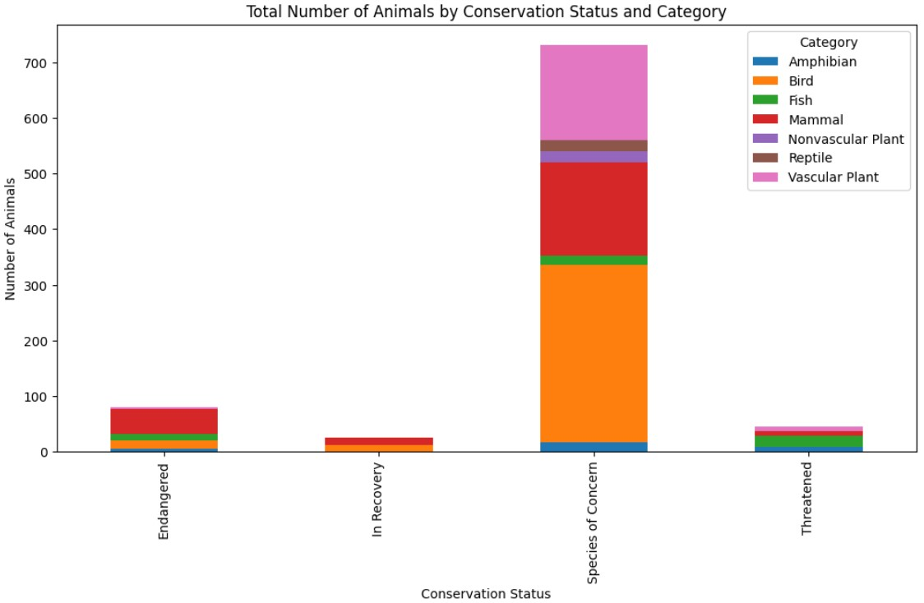
Analysis #1
The number of Conservation Status Species of Concern is dominated by Bird.
The number of Conservation Status Endangered is dominated by Mammal.
The number of Conservation Status In Recovery is dominated by Mammal and Bird.
The number of Conservation Status Threatened is dominated by Fish.

Slide 3
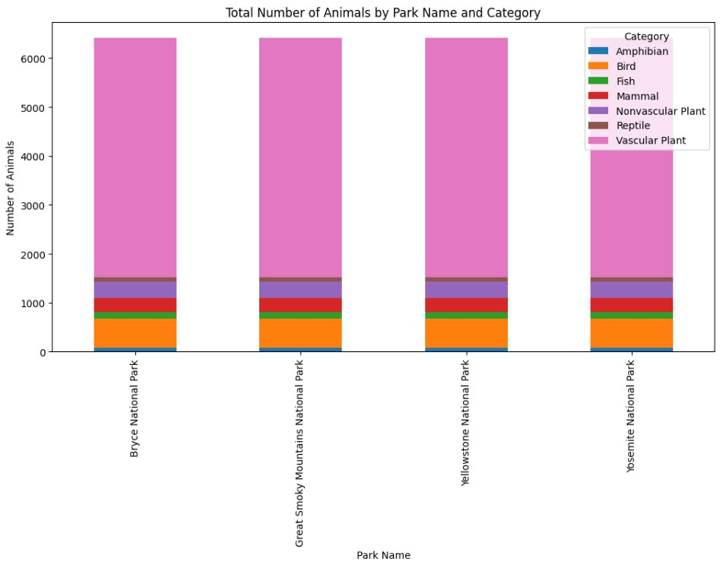
Analysis #2
There is no difference in the number of Animals throughout the park.

Slide 4
Analysis #3
Performed a chi-squared test between "Park Name" and "Conservation Status" to assess the association.
Set the significance level (alpha) to 0.05.
The result:
"There is no statistically significant association between Park Name and Conservation Status."

Slide 5
Recommendation
Based on the insights and significance calculations, here are recommendations for conservationists concerned about endangered species:
Prioritize conservation efforts for species in the "Endangered" category, especially those belonging to the dominant groups (e.g., mammals).
Collaborate with experts and organizations specializing in the conservation of the dominant species in each category.
Allocate resources for research, habitat protection, and breeding programs targeting species of concern.

Slide 6
Recommendation
Develop strategies to raise public awareness and support for the conservation of these species.
Consider adaptive management techniques to address conservation challenges efficiently.
These recommendations aim to enhance conservation efforts and increase the likelihood of protecting endangered species and their habitats.

Slide 7

Thank You!

